Slide 1
Multimedia Systems Lecture – 4
By
Dr. Priyambada Subudhi
Assistant Professor
IIIT Sri City

Slide 2
Text: Visual Representation
Text has become a part of our life. It consists of characters, punctuation symbols, etc. to convey a message.
Text is one of the most imperative components of multimedia and an essential source of presenting information to a wide range of people.
Proper use of text, keeping in mind elements such as font style, size and various design tools help the content creator to communicate the idea and message to the user.

Slide 3
Fonts and Faces
Factors affecting legibility of text are as follows:
Size and style
Background and foreground colours
Leading
A glyph is a graphic representation of a character’s shape where a character may be represented by many glyphs.
A typeface is the design of lettering that include variations in size, weight, slope, width etc.
A font is a collection of character or glyphs of a single size and style belonging to a particular typeface family.
Fonts are classified on the basis of spacing between characters, words, presence or absence of serifs, their shape, stretch and weight such as bold or italics.

Slide 4
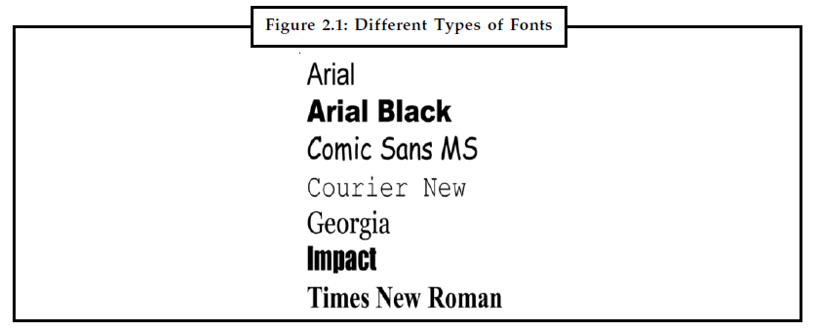
The spacing between character pairs is called kerning and the space between lines is called leading.

Slide 5
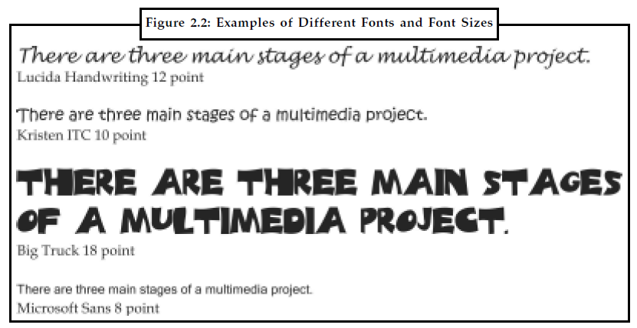
Font size is measured in points and it does not describe the height or width of its character. This happens because the height of two different fonts (in both upper and lower case) may differ.
One point is approximately 1/72 of an inch i.e., 0.0138.

Slide 6
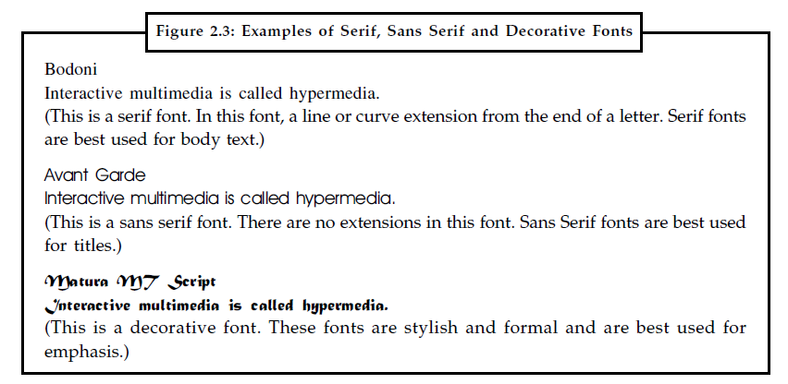
Example: Times New Roman, Bodoni, Bookman are some fonts which come under serif category.
Arial, Avant Garde, Verdana are some examples of sans serif font.

Slide 7
Selecting Text Fonts
There are a few things that a user must keep in mind before selecting fonts for a multimedia presentation.
Choose a font that is legible and easy to read.
The different effects and colours of a font can be chosen to make the text look distinctive.
Try to use few different colours within the same presentation.
Try to use few typefaces within the same presentation. Play with the style and size to match up to the purpose and importance of the text.
Drop caps and initial caps can be used to accent the words.
To attract instant attention to the text, the words can be wrapped onto a sphere or bent like a wave.
In case of text links (anchors) on web pages the messages can be highlighted.
Meaningful words and phrases can be used for links and menu items.
Overcrowding of text on a single page should be avoided.
Do not use decorative passages for longer paragraphs.

Slide 8
Using Text Elements in a Multimedia Presentation
The text elements used in multimedia are given below:
Menus for Navigation
A user navigates through content using a menu.
A simple menu consists of a text list of topics.
Interactive Buttons
A button is a clickable object that executes a command when activated.
Users can create their own buttons from bitmaps and graphics.
The design and labelling of the buttons should be treated as an industrial art project.
Fields for Reading
Reading a hard copy is easier and faster than reading from the computer screen.
A document can be printed in one of two orientations - portrait or landscape.

Slide 9
HTML Documents
HTML stands for Hypertext Markup Language which is the standard document format used for Web pages.
HTML documents are marked using tags.
Some of the commonly used tags are:
The <B> tag for making text bold faced.
The <OL> tag for creating an ordered list.
The <IMG> tag for inserting images.
Text Layout
While creating a multimedia presentation, the presenter should plan the text layout to let a reader read it with ease.
The length of the text should neither too long nor too short.
For a printed document, a line containing 13 to 17 words is sufficient.
The next point of concern is the consistency of pages. The designer has to make sure that the pages should be of same size.

Slide 10
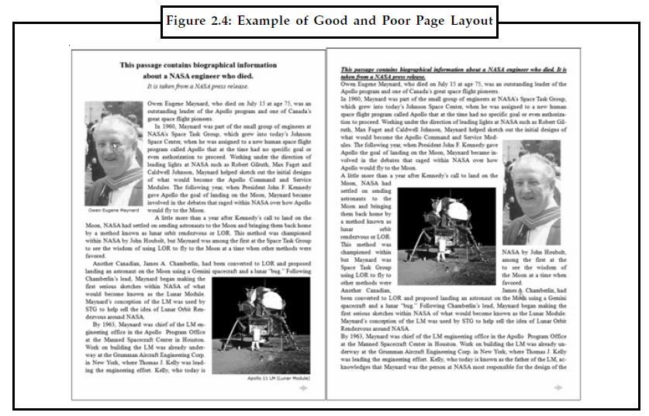

Slide 11
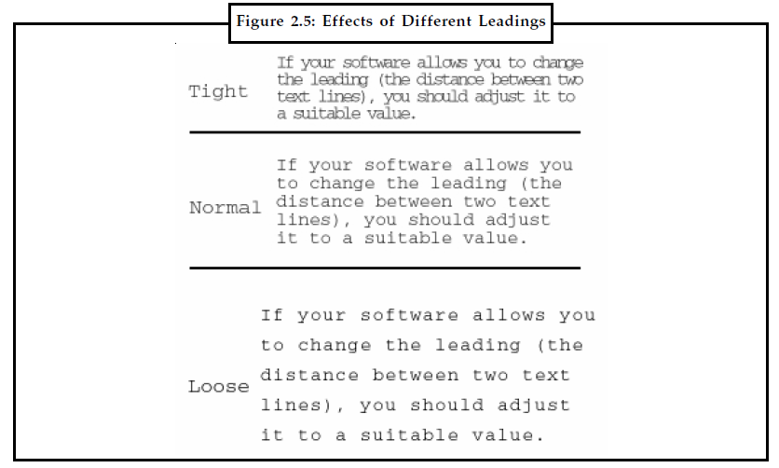
The distance between two lines should be adjusted to a suitable value to increase readability.
Ensure that the leading is not too small as then the text will be hard to read.

Slide 12
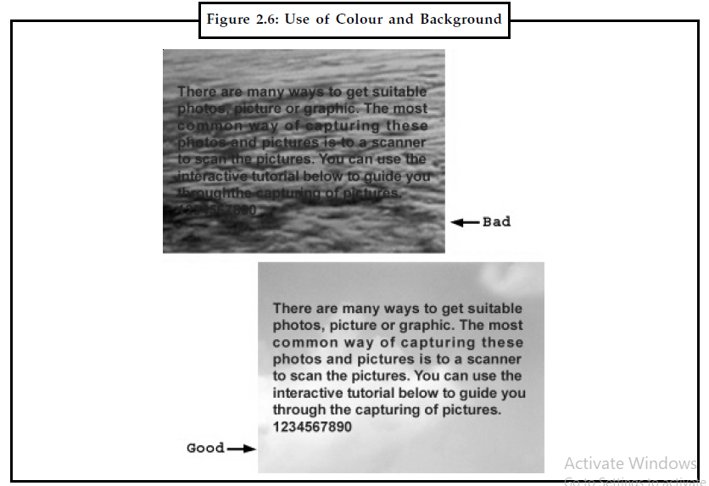
The other one of the most common errors people make is while choosing the background colour. Using a background colour too close to the text or a background image highly in contrast to the text which makes the text difficult to read.

Slide 13
Use of Text in Webs
Using text in websites attract a visitor’s attention as well as help him in understanding the webpage better.
It is far better than the use of meaningless graphics and images which do not contribute in understanding of the page.
Website Loading Speed: A website which contains a lot of text loads faster than the websites that contains a lot of images and graphics, audio and video clips on the page.

Slide 14
Text in Films
Most films start with titles and end with credits.
Typography look different in different formats such as a in film subtitles, on websites, poster etc.
While designing subtitles, a film maker will need to keep in mind that moving images interact with the top layer subtitles.
E.g. If subtitles are white and rest on top of a similar white tone in the image, the text will be difficult and impossible to read. To ensure this does not happen, a black outline around text should be used. Now the text will be viewable even against common black and white backgrounds.

Slide 15
Text in Advertisements
Since the text ads are more of keyword oriented, they draw more attention than banner advertising.
The text ads are inexpensive, thus making it affordable and effective for your business.
There are a few websites which offers a flat free rental services to place your text based advertisements.
The foremost benefit of having text based advertisements is that it helps in improving your search engine ranking.

